Slide 1
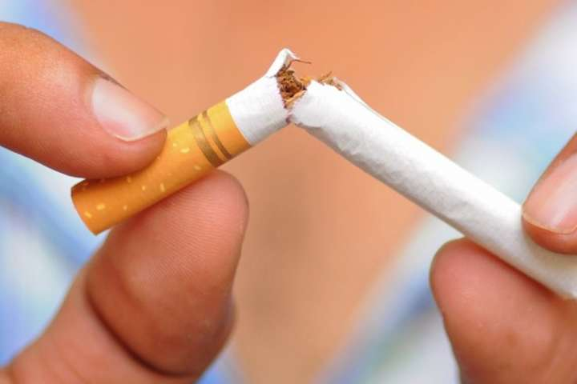
Dangers from Using Drugs, Alcohol, Unhealthy Food, Smoking
Done by Mankivskiy Vlad
WT-21-1[2]

Slide 2

Harm of drugs
Drug use develops drug addiction
Seizures, severe pain in muscles and internal organs.

Slide 3
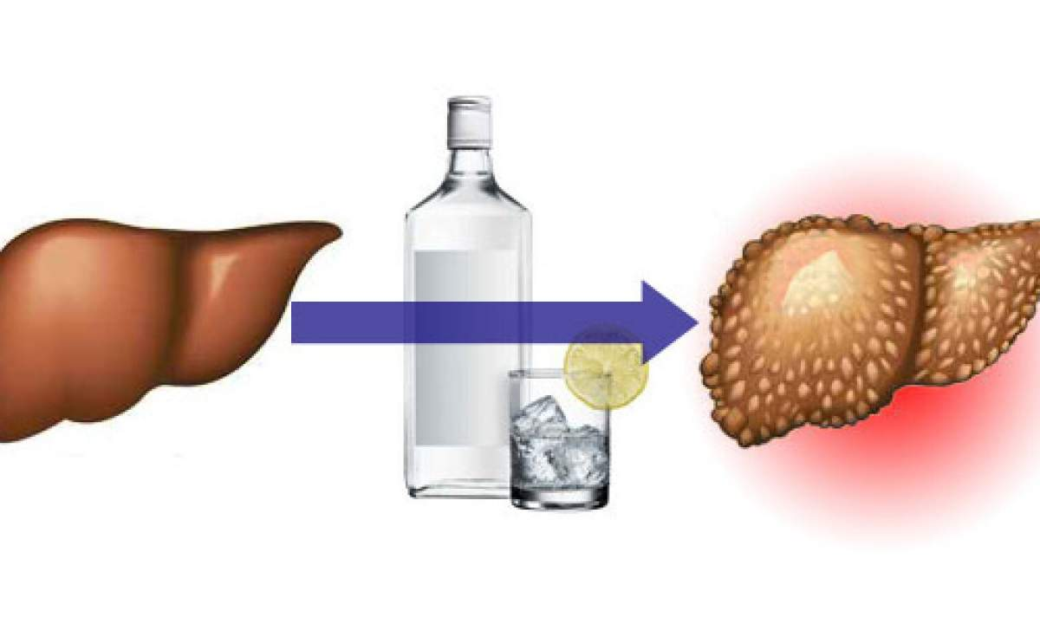
Harm of alcohol
It affects the brain, heart, lungs, stomach, liver, kidneys.

Slide 4
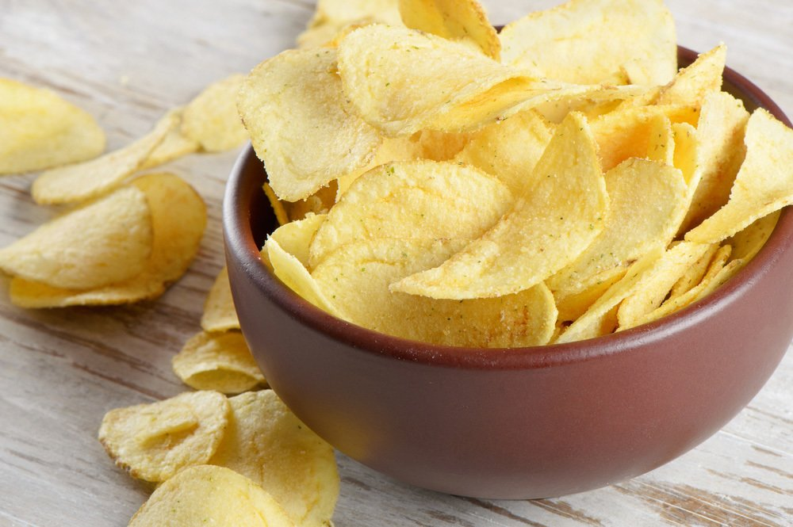
Harm of unhealthy food
Nutritionists do not often recommend that you eat fast food, so it is likely to gain extra pounds
People who eat fast food are more prone to depression than those who eat a healthy diet
Fast food causes premature aging;
Fast food impairs memory
The faster we chew food, the less we get full, and in the end we eat more

Slide 5
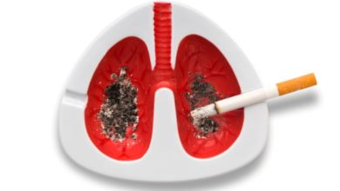
Harm of smoking
Tobacco smoke contains more than 7,000 chemical elements, of which at least 250 are toxic and about 70 cause cancer.

